Slide 1

Car Dekho Market Trends Analysis
AICTE STU ID : STU6a66eedfe85331785130719
[Karen Acharya]

Slide 2

PROBLEM STATEMENT
Core Problem: The used car market lacks transparent pricing benchmarks, making it difficult for buyers and sellers to assess fair valuation and predict vehicle depreciation.
Key Questions Addressed:
  What are the historical vehicle manufacturing year ranges and price distributions?
  Which vehicle models and fuel types experience the fastest depreciation?
  How strong is the correlation between vehicle age/mileage and overall market price loss?

Slide 3
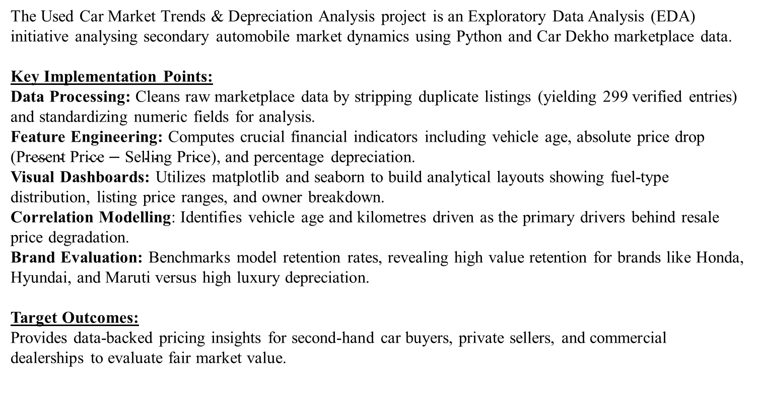
The Used Car Market Trends & Depreciation Analysis project is an Exploratory Data Analysis (EDA) initiative analysing secondary automobile market dynamics using Python and Car Dekho marketplace data.
Key Implementation Points:
Data Processing: Cleans raw marketplace data by stripping duplicate listings (yielding 299 verified entries) and standardizing numeric fields for analysis.
Feature Engineering: Computes crucial financial indicators including vehicle age, absolute price drop ($\text{Present Price}−\text{Selling Price}$), and percentage depreciation.
Visual Dashboards: Utilizes matplotlib and seaborn to build analytical layouts showing fuel-type distribution, listing price ranges, and owner breakdown.
Correlation Modelling: Identifies vehicle age and kilometres driven as the primary drivers behind resale price degradation.
Brand Evaluation: Benchmarks model retention rates, revealing high value retention for brands like Honda, Hyundai, and Maruti versus high luxury depreciation.
Target Outcomes:
Provides data-backed pricing insights for second-hand car buyers, private sellers, and commercial dealerships to evaluate fair market value.
PROJECT DESCRIPTION:

Slide 4

WHO ARE THE END USERS?
End Users & Target Audience:
Used Car Buyers: Individuals looking to purchase pre-owned vehicles who need transparent data on fair market prices, budget-friendly models, and vehicles with lower long-term depreciation.
Private Sellers & Dealerships: Car owners and commercial used-car dealers seeking data-driven pricing benchmarks to value listings competitively based on mileage and brand retention.
Automotive Market Analysts: Industry researchers evaluating market trends across fuel types (Petrol, Diesel, CNG), transmission models (Manual vs. Automatic), and single-owner valuation premiums.
Financial & Insurance Evaluators: Professionals estimating vehicle residual value and collateral risk based on age and usage correlations.

Slide 5

TECHNOLOGY USED:
Language: Python 3
Libraries:
  pandas — Data loading, cleaning, manipulation, and feature engineering
  numpy — Array computation and numerical metrics calculation
  matplotlib — Base visualization canvas and subplot layout configuration
  seaborn — Distribution boxplots and correlation heatmap generation
Environment: Google Colab / Jupyter Notebook / GitHub repository hosting

Slide 6
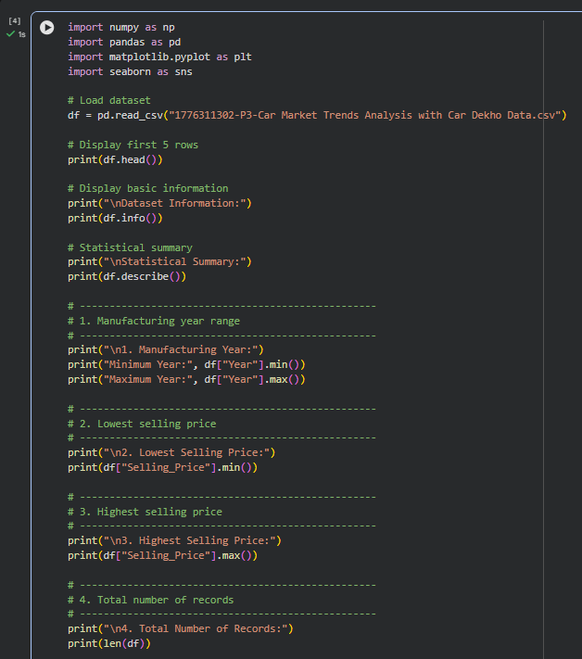
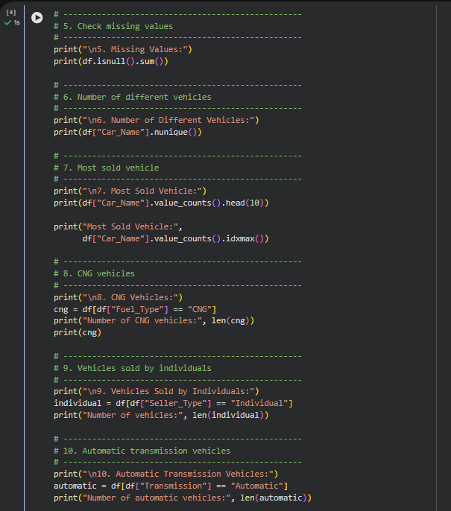
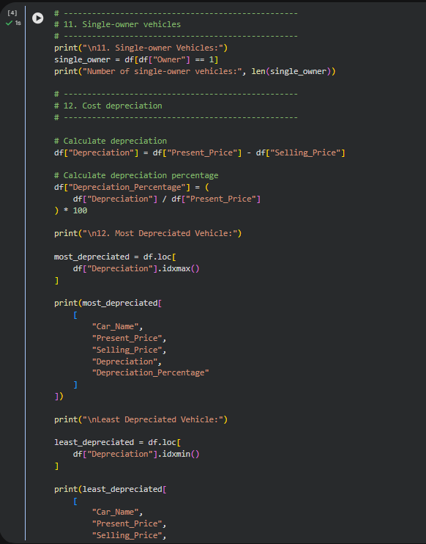
RESULTS:
Github Link

Slide 7
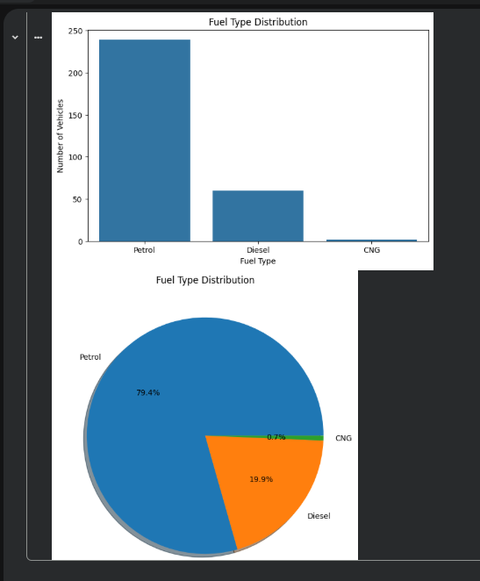
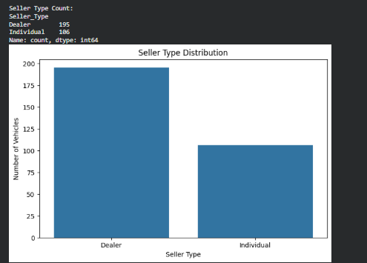
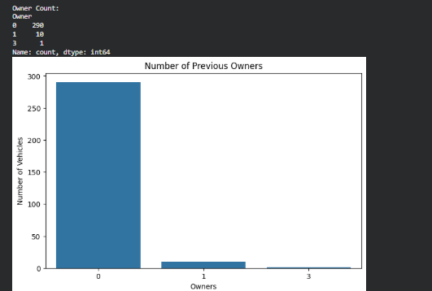
RESULTS:
Github Link

Slide 8
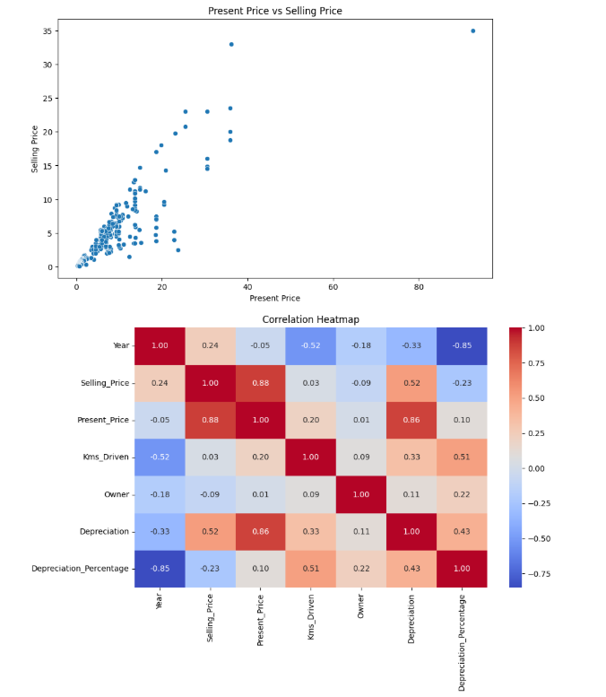
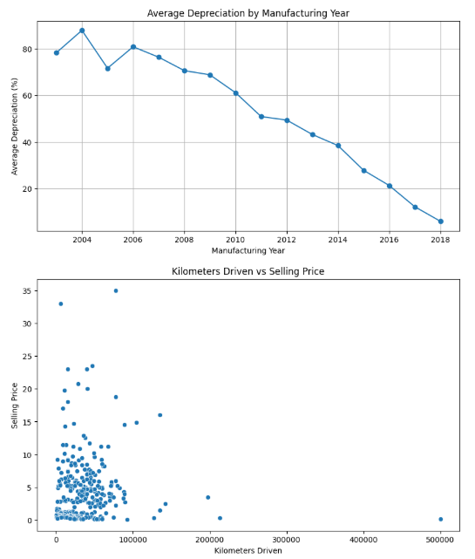
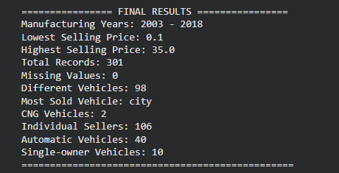
RESULTS:
Github Link

Slide 9
Thank you
[Karen Acharya]
AICTE STU ID : STU6a66eedfe85331785130719
Email: karenacharya24@gmail.com
Mobile No.: 8697355268
Github Link: https://github.com/karenacharya24-boop/car-dekho-analysis
.
.

